Slide 1
Languages
Slides: Konstantin Busch, LSU
https://cse.lsu.edu/~busch/courses/theorycomp/
Prof. Busch - LSU

Slide 2
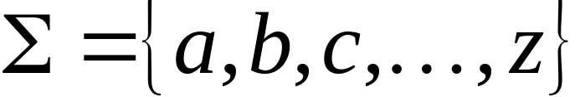
Language: a set of strings
String: a sequence of symbols
from some alphabet
Example:
Strings: cat, dog, house
Language: {cat, dog, house}
Alphabet:
Prof. Busch - LSU

Slide 3

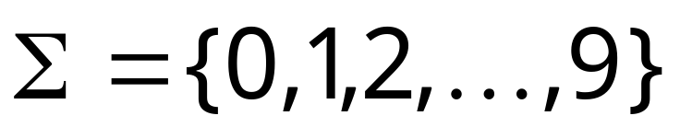
Languages are used to describe
computation problems:
Alphabet:
Prof. Busch - LSU

Slide 4

Computation is translated to set membership
Example computation problem:
Is number prime?
Equivalent set membership problem:
Prof. Busch - LSU

Slide 5

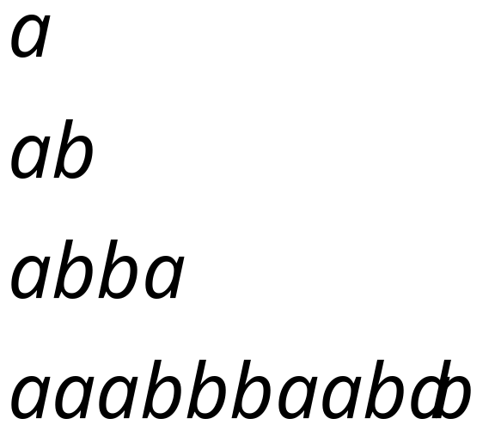
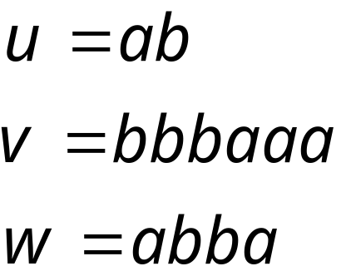
Alphabets and Strings
An alphabet is a set of symbols
Example Alphabet:
A string is a sequence of
symbols from the alphabet
String variables
Example Strings
Prof. Busch - LSU

Slide 6
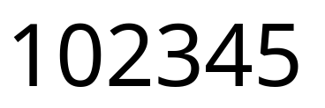
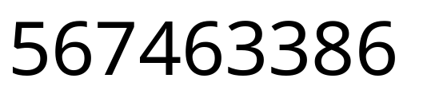
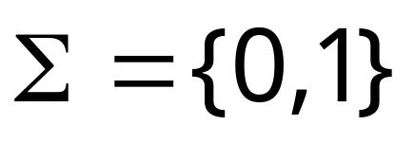


Decimal numbers alphabet
Binary numbers alphabet
Prof. Busch - LSU

Slide 7
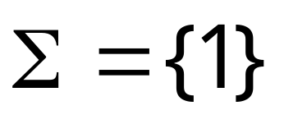

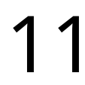
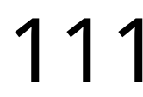
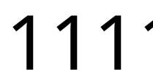
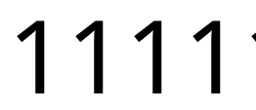




Unary numbers alphabet
Unary number:
Decimal number:
Prof. Busch - LSU

Slide 8
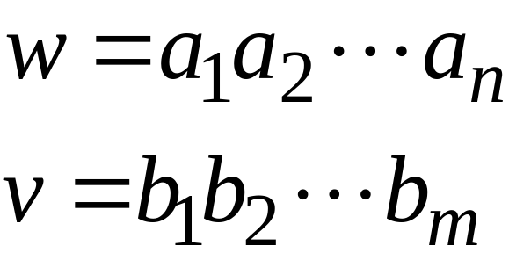
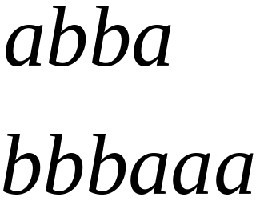
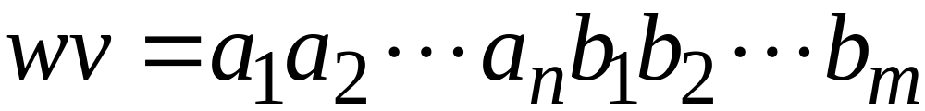

String Operations
Concatenation
Prof. Busch - LSU

Slide 9




Reverse
Prof. Busch - LSU

Slide 10


String Length
Length:
Examples:
Prof. Busch - LSU

Slide 11


Length of Concatenation
Example:
Prof. Busch - LSU

Slide 12
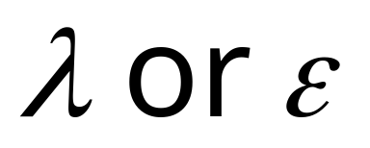
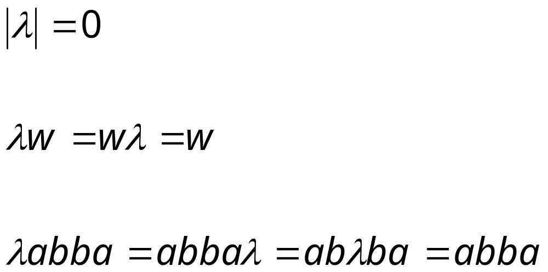
Empty String
A string with no letters is denoted:
Acts as a neutral element
Observations:
Prof. Busch - LSU

Slide 13


Substring
Substring of string:
  a subsequence of consecutive characters
String Substring
Prof. Busch - LSU

Slide 14




Prefix and Suffix
Prefixes Suffixes
string
prefix
suffix
Prof. Busch - LSU

Slide 15




Exponent Operation
Example:
Definition:
Prof. Busch - LSU

Slide 16



The * Operation
: the set of all possible strings from
alphabet
Prof. Busch - LSU

Slide 17


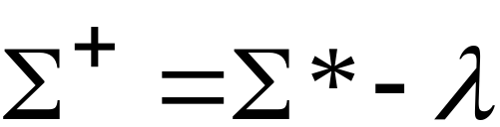
The + Operation
: the set of all possible strings from
alphabet except
Prof. Busch - LSU

Slide 18


Languages
A language over alphabet
is any subset of
Example:
Language:
Language:
Language:
Prof. Busch - LSU

Slide 19
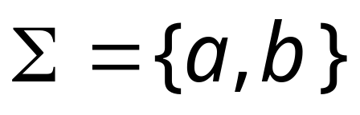


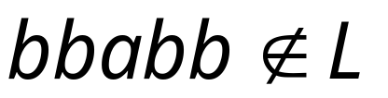
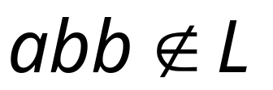

More Language Examples
An infinite language
Alphabet
Prof. Busch - LSU

Slide 20

Prime numbers
Alphabet
Language:
Prof. Busch - LSU

Slide 21
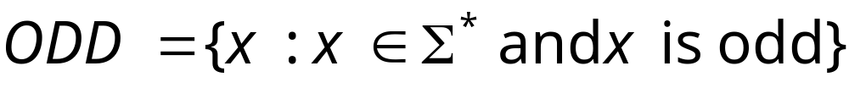

Even and odd numbers
Alphabet
Languages:
Prof. Busch - LSU

Slide 22
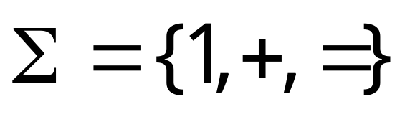
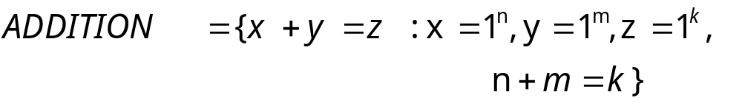
Addition (of unary numbers)
Alphabet:
Language:
Prof. Busch - LSU

Slide 23
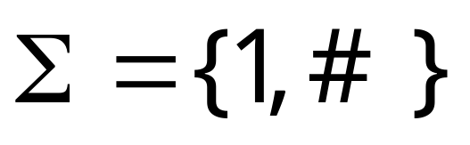

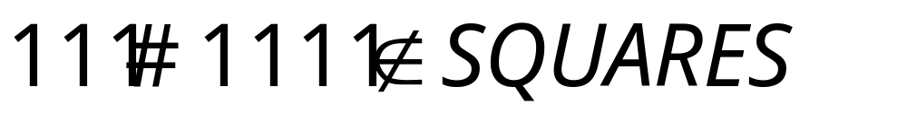
Squares (of unary numbers)
Alphabet:
Language:
Prof. Busch - LSU

Slide 24

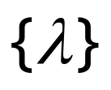
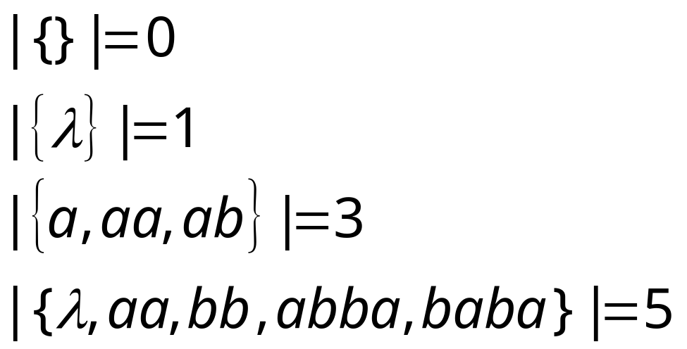
Two special languages
Language with
empty string
Empty language
Size of a language (number of elements):
Prof. Busch - LSU

Slide 25




Note that:
Sets
Set size
Set size
String length
Prof. Busch - LSU

Slide 26


Operations on Languages
The usual set operations
Complement:
Prof. Busch - LSU

Slide 27



Reverse
Definition:
Examples:
Prof. Busch - LSU

Slide 28


Concatenation
Definition:
Example:
Prof. Busch - LSU

Slide 29



Another Operation
Definition:
Special case:
Prof. Busch - LSU

Slide 30



Example
Prof. Busch - LSU

Slide 31



Star-Closure (Kleene *)
All strings that can be constructed from
Definition:
Example:
Prof. Busch - LSU

Slide 32
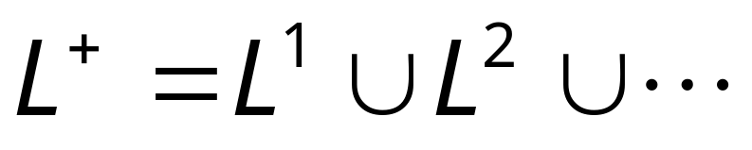

Positive Closure
Definition:
Prof. Busch - LSU

